Slide 1

Teaching in England – the first year
Notes:
Great Britain doesn’t operate as one country for education. The systems are different in Scotland and Northern Ireland, and also in Wales. Devolved government within the UK has, if anything, increased this trend. Much of what I say would also apply to Wales, but it certainly wouldn’t apply to Scotland or Northern Ireland.

Slide 2
Many pathways into teaching
PGCE
GTP
SCITT
A-BT
BEd
BA/BSc with QTs
OU
AO
TtT
TeachFirst
OTTP
Notes:
There are many routes by which people in England can become teachers. Those on the screen may well not be all of them! I am going to concentrate on the most frequently used route, the PGCE.

Slide 3
The PGCE route (1)
Study for first degree – BSc or BA (3 years)
Immediately (or later) take a 1-year Post Graduate Certificate in Education.
(Course includes:
THEORY
and
PRACTICE (School Placements)
If successful, QTS is awarded.
Notes:
Graduates are expected to contact a school to do some informal observation before the course starts – usually somewhere near home once their degree studies have finished. It is not unusual for some graduates to spend a few years doing something else before they decide to teach. 3 of the 8 teachers I have worked with were 26 (or thereabouts) before being certain that teaching was what they wanted to do.

Slide 4
The PGCE route (2)
Apply for jobs at school(s) where you would like to work.
Attend interview(s) and accept the best job offer.
You will have a trained Induction Tutor.
Other teachers working in the same department of the school, or with the same age group, will be asked to be Mentors to help you to settle in and understand how the school works.
Notes:
Not every school will say that job applications from an NQT are welcome. NQTs cost the school less in salary payments, but they create a lot of extra work and responsibility if they are guided properly through the first year.
The lesson planning aspect of an NQT’s work is usually dealt with by meetings with fellow teachers who teach the same subject(s) and age groups of children.

Slide 5
Meeting your Induction Tutor
1
Before the start of the first term, you (and any other NQTs) will meet your Induction Tutor.
The school will register you with the national Teacher Induction Panel and will pay the fee for your Induction Year.
Your IT will go through 2 ‘checklists’ with you and will explain the arrangements about weekly meetings.
Notes:
At the first meeting, we explain how the organisation of first year works. Checklists make sure that nothing important is overlooked or forgotten. The ‘structure’ of the year is outlined. The NQTs are given copies of various documents which they will come across during the year, so that they are familiar with them. They are introduced to the website for Teacher Induction. They are given details of who they could contact if things went badly wrong and they needed help from outside the school.

Slide 6
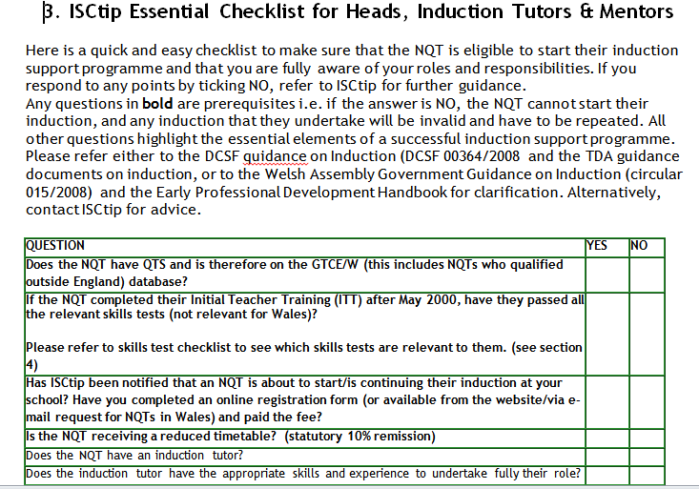

Slide 7
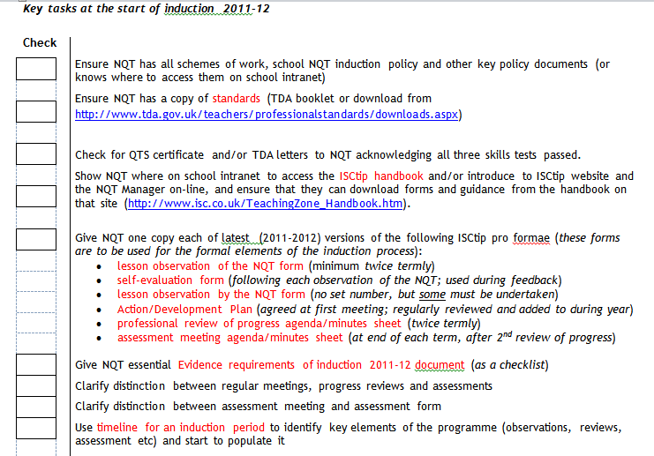

Slide 8
Meeting your Induction Tutor
2
The IT will tell (or remind you) that you are no longer a student, but a qualified teacher. You finished your PGCE year with QTS (Qualified Teacher Status)!
During your Induction Year, the school has responsibilities to you, but you will have some responsibilities as well!
Together, you look at your teaching timetable and agree a convenient time for your Regular Weekly Meeting – this is the ‘heart’ of the whole process.
Notes:
Some new teachers think, when they start their first job, that the Induction Year is something that the school does ‘to them’ or ‘for them’ – the reality is that the NQT takes ownership and increasing responsibility for how the year progresses, as the next slide shows.
The weekly meeting is ‘ring fenced’ – the NQT will not be used to take a lesson for a teacher who is absent. They must turn up on time, and the Tutor must be expecting them and ready for them. I want to show you how the agenda covers valuable aspects of progress and keeps an important focus on essential aspects of Induction.

Slide 9
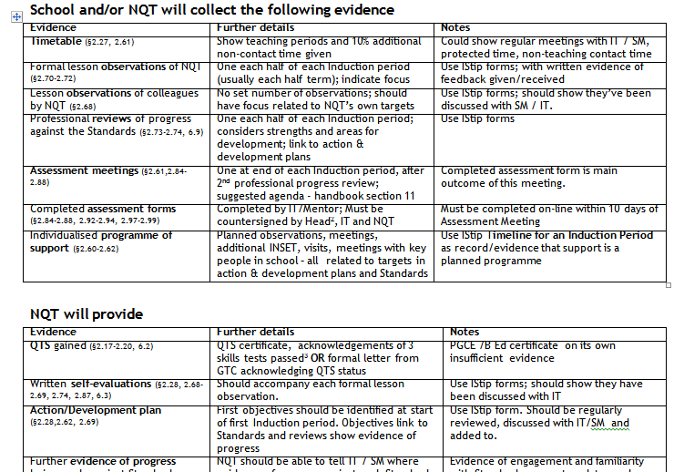

Slide 10
The Weekly Meeting
Each meeting follows an agenda. This sounds bureaucratic, but it is really helpful! There is a copy for you to look at – I will explain why it is so helpful to use this agenda every week……..
I would like to talk to you about each section of the form, and how it is useful to the NQT and to the Tutor (me)!
  Progress made with last meeting’s action points
Notes:
The name and date at the top of the form help me with filing in the correct file and in the right order.
The first item on the agenda ensures ‘action points’ are actually dealt with, by both NQT and Tutor. Things don’t ‘get forgotten’ or slip through the net.

Slide 11
  Most satisfactory lesson since last meeting (Why?)
Notes:
Reflect, identify, unpack, reflect, decide. I usually say that it need not be a whole lesson, there might be an aspect of a lesson which was really pleasing. It might be the way it was planned, the teaching resources which were selected, the way something was explained, the way the children reacted, the completed work from the lesson……..and so on. It is important for this process to become ‘embedded’ so that the teacher becomes what is currently called a ‘reflective practitioner’.
The teacher is encouraged to ‘annotate’ her teaching plans accordingly for the following year (or the next teacher).

Slide 12
Least satisfactory lesson since last meeting (Why?)
Notes:
This is similar to the previous topic, but in reverse. It opens up the possibility (even the expectation) that sometimes things will not go according to plan! The main thing is for the NQT to be able to identify what went wrong and, very importantly, to feel able to talk about it. It’s important for the Tutor not to be ‘judgemental’ but to face up to the issue and ‘unpack’ why something went wrong. For one of the teachers I have worked with, it was admitting that she left one of her resources at home because she didn’t check carefully enough before setting off – she never did that again! Others have said that they still didn’t really yet know well enough the abilities of the children they were teaching. Last year a teacher had to leave at very short notice because her husband was diagnosed with a terminal illness. An NQT was working in the school as a teaching assistant because she left it too late to apply for a teaching job when she left college the previous summer. She had been identified as a very capable and promising teacher and was offered promotion to the job. In the early weeks she would sometimes tell me that everyone finished too early because she hadn’t got her timing right and the task was too easy. At other times, she realised that she had to re-phrase explanations so that the children could understand a new concept. (And she also had to deal with the emotional upset felt by the children at the loss of a first-rate and very popular teacher too!) Nobody is perfect, but everyone can become a ‘reflective practitioner’ if they analyse why particular aspects of lessons are successful (or not)!

Slide 13
Progress with each teaching group since last meeting
Notes:
This encourages the teacher to talk through an ‘overview’ of how each class is getting on. There are often some valuable points raised which might not otherwise have been discussed, and which help to show how the NQT is approaching her work.

Slide 14
Evidence-gathering related to standards since last meeting
(attributes, knowledge & understanding, or skills)
Notes:
We will come back to this one later! If you look at the column on the right-hand side of the page, you will see the words ‘Related Standards’. If we have time, I will say a little about the 41 standards, covering the 3 aspects referred to: Professional attributes (attitude, outlook etc), knowledge and understanding of ‘things teachers are expected to know about……and understand’ what to do if the need arises.

Slide 15
Additional planned use of 10% protected time (e.g. observing lessons, form shadowing, consulting with specialist colleagues [e.g SENCO, ICT], visits to other schools)
Notes:
During the first year, an NQT has a ‘reduced timetable’. The school has to identify how much teaching would be done by a teacher without any additional responsibilities with a similar age-group or subject(s), then reduce by 10% the amount of teaching done by an NQT. This is called ‘protected time’. It is all too easy to ‘fritter away’ the time in marking and routine planning. The extra time is made available for the teacher to do the sort of things listed here – and to make sure that use of it is planned. One of the most worthwhile things to do is to watch an experienced teacher at work, and from that, to get ideas that could be used or adapted in their own practice. ‘Form shadowing’ means watching their own class being taught by someone else. It could mean following the class round for part of a day to see what the experience is like for them. SENCO is the teacher responsible for organising/giving learning support to children who need it, or advising colleagues about how to teach these children successfully. ICT – use of technology in teaching. It’s also worth looking at the different ways in which other schools do things – no 2 schools are the same.

Slide 16
Action point(s) for next meeting
Notes:
At this point in the meeting, the NQT confirms anything that she has said she will do before the next meeting. The Tutor does the same. Once it has been put in writing, both people are more likely to remember to do what they have said! As you will already have noticed, it is the first item on the agenda for the following week – this is a good way of being certain that you both do what you have said you will do!

Slide 17
Help needed !!!
Notes:
This is the weekly opportunity for the NQT to talk about anything that help is needed with. It might be something quite small, but it is also a chance for the NQT to mention anything that is a problem, that cannot be dealt with alone, or that is growing in importance and might become a big problem if it is not dealt with. Sometimes the NQT feels unable to approach another member of staff about observing a lesson, or does not know how to set about asking the Head of the school for consent to visit another school. Big or small, a problem never has to wait for more than a week before there is an opportunity to ask for help.

Slide 18
Action & development plan reviewed
Yes/No
Notes:
I will show you what an Action & Development plan looks like on the next slide.

Slide 19
Induction Action & Development Plan, 2011-12
NQT: (name) |  | Induction Tutor: (name) |  | Time Period: (term/half term)
Objectives / Areas for Development – linked to Core Standards | Timescales / target dates | Support arrangements – activities, people | Success Criteria – what are we looking for? | Evidence of completion – where, when and what | Reviewed – initials, dates
Here the NQT writes one aspect of their work on which they would like to improve. The ‘target’ will link to one or more of the National Standards. | This could be a definite date, or a half or whole term, or it could be ‘ongoing’ | This is what the NQT plans to do, who to meet for discussion, who to approach for specialist advice etc. | Here the NQT will decide what will be achieved so that the target has been met. | This will be something clearly identifiable (or measurable) so that the NQT can demonstrate that the target has been met. | The NQT and tutor will initial and date every time the target is discussed in a weekly meeting.
Notes:
Every half term, the NQT decides on the areas where they would particularly like to develop or improve. It is up to the NQT to select the ‘targets’, but they are discussed with the tutor to make sure they are realistic and are the priorities which need special attention.
At every weekly meeting, the NQT and tutor decide if there is something to add, comment on, or change in any of the target areas.
At the end of each half term, the NQT and tutor discuss how much progress has been made. Targets can be ‘signed off’ as completed, changed/updated, or carried forward for more attention to the next half term.

Slide 20
Timeline reviewed and dates added
Yes/No
Notes:
At each weekly meeting the tutor will check with the NQT if there are any items to be added to the document called the ‘Timeline’. This is a record of the special events which form the programme of support for each individual NQT, as you will see on the next slide.

Slide 21
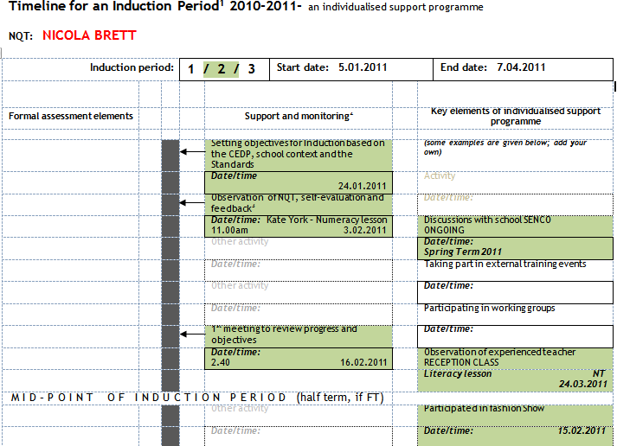

Slide 22
NQT Initials………….. IT initials……………
Date:…………..
Notes:
At the end of the meeting, the NQT and tutor decide which one of them will write the minutes of the meeting and add the information asked for in the right-hand column on the sheet. Usually I offer to do this because I have more time available than the NQT does! Quite often, the notes are made in handwriting during the meeting, so only the ‘Related Standards’ need to be added. Why do we bother to do this?
At the end of each term, a report has to be sent from the school to the National Teacher Induction Panel. The report is compiled by the NQT and tutor, the tutor writes the final draft, the NQT checks it, then the headteacher is sent a copy to read. The NQT is required to write a comment on how much progress she/he thinks has been made, what they would like to say about the report, and any other comments they would like to make. Both documents are sent electronically, and are signed electronically. The report will not be accepted without the comment from the NQT! A few days after the report has been uploaded, the tutor is notified if the report has been accepted and authorised.
The 3rd and final report has to contain a recommendation about whether (or not) the NQT has met all the ‘Core Standards’ during the course of the year! If they haven’t, they will not pass! So what are these Standards?

Slide 23
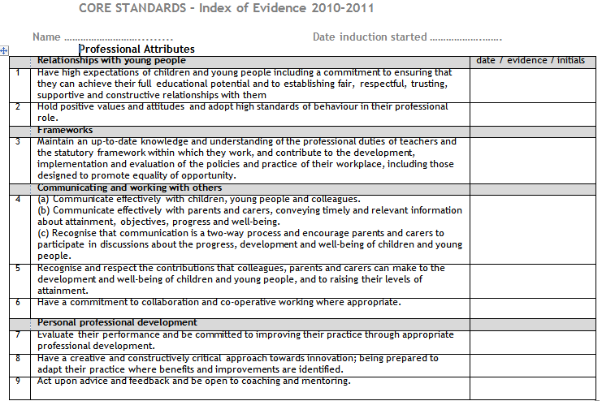

Slide 24
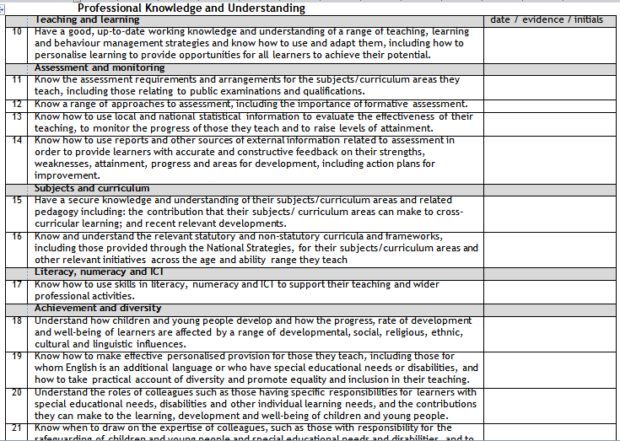

Slide 25
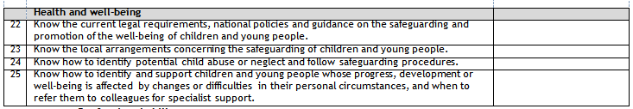

Slide 26
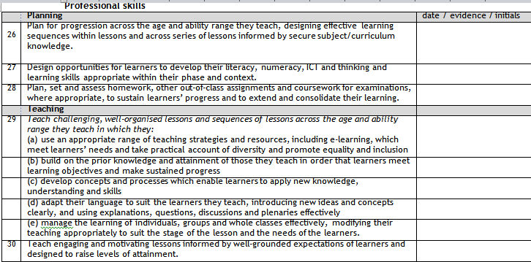

Slide 27
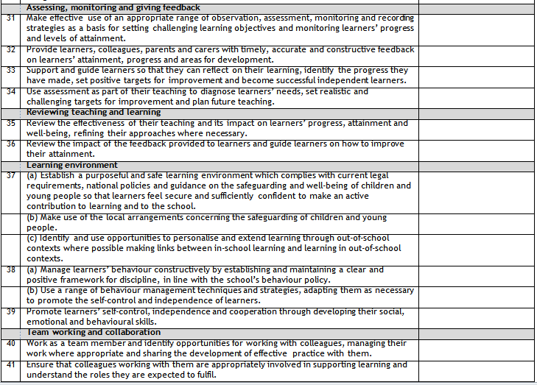
Notes:
You may well ask, how on earth does the NQT keep track of which standards she/he can state that they have evidence to show they have met them? That takes us back to slide no 14.

Slide 28
Evidence-gathering related to standards since last meeting
(attributes, knowledge & understanding, or skills)
Notes:
……also to the right-hand column of the weekly meeting form, and to one of the responsibilities which the NQT has to deal with! They have to keep a record of the evidence that they can provide to show that they have met each standard (and the date on which the evidence took place)!

Slide 29
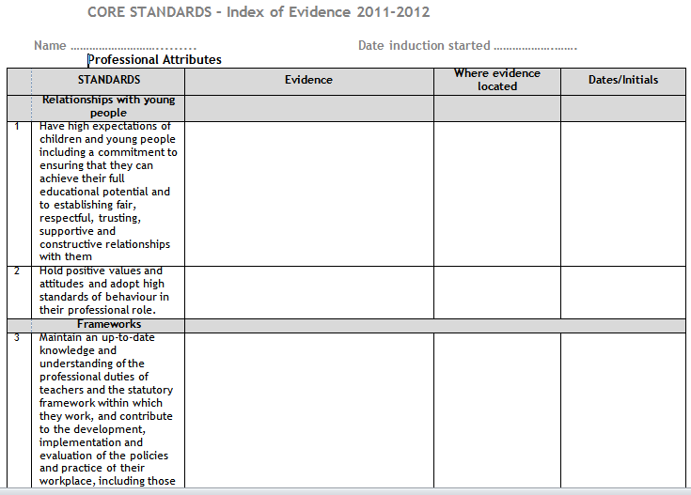
Notes:
So we provide a copy of the Index of Evidence, cunningly adapted by the tutor for the NQT!!
Evidence can be many things: notes from the weekly meeting, photographs, notes or emails from parents, comments from other members of staff, children’s exercise books, the lesson plans, reports written to parents, attending a special course or information session for staff….the list is endless, but at the time of writing the final report, the tutor has to be able to state that the NQT has met all of the standards and has evidence for doing so!

Slide 30
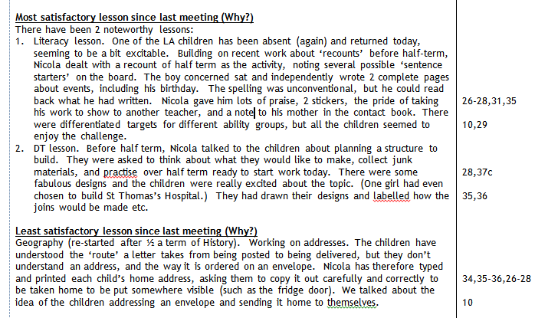
Notes:
Let’s go back to the sheets for the weekly meeting, and look at the right-hand column. Here is one place where the tutor can add the standards to the sheet, and it is one of the many forms of evidence that the NQT can assemble during the year. There you can see which standards had been involved in that discussion at a weekly meeting. If we just go back for a minute toa previous slide…..

Slide 31
Notes:
….you will see that the Professional Knowledge and Understanding standards are just that – knowing and understanding….. . The tutor can decide when they are satisfied that these standards, and the………

Slide 32
Notes:
ones about health and well-being have been met and can be signed off! The NQT doesn’t have to go on collecting evidence once the tutor has said they are satisfied that a particular standard has been met. But I do want you to know that the NQTs survive the Induction Year and can still smile about it!

Slide 33

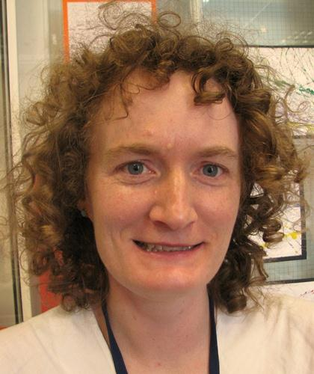

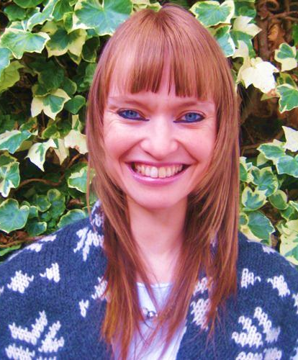
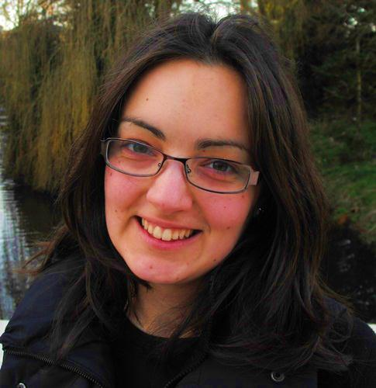
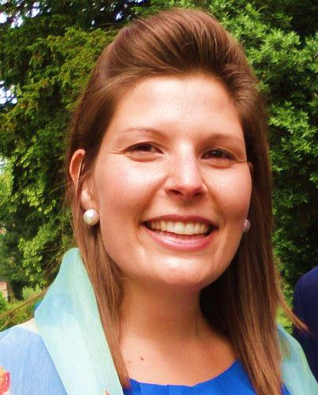


Notes:
and here they are! (Note from Kate – there are more pictures to follow!)

